Slide 1
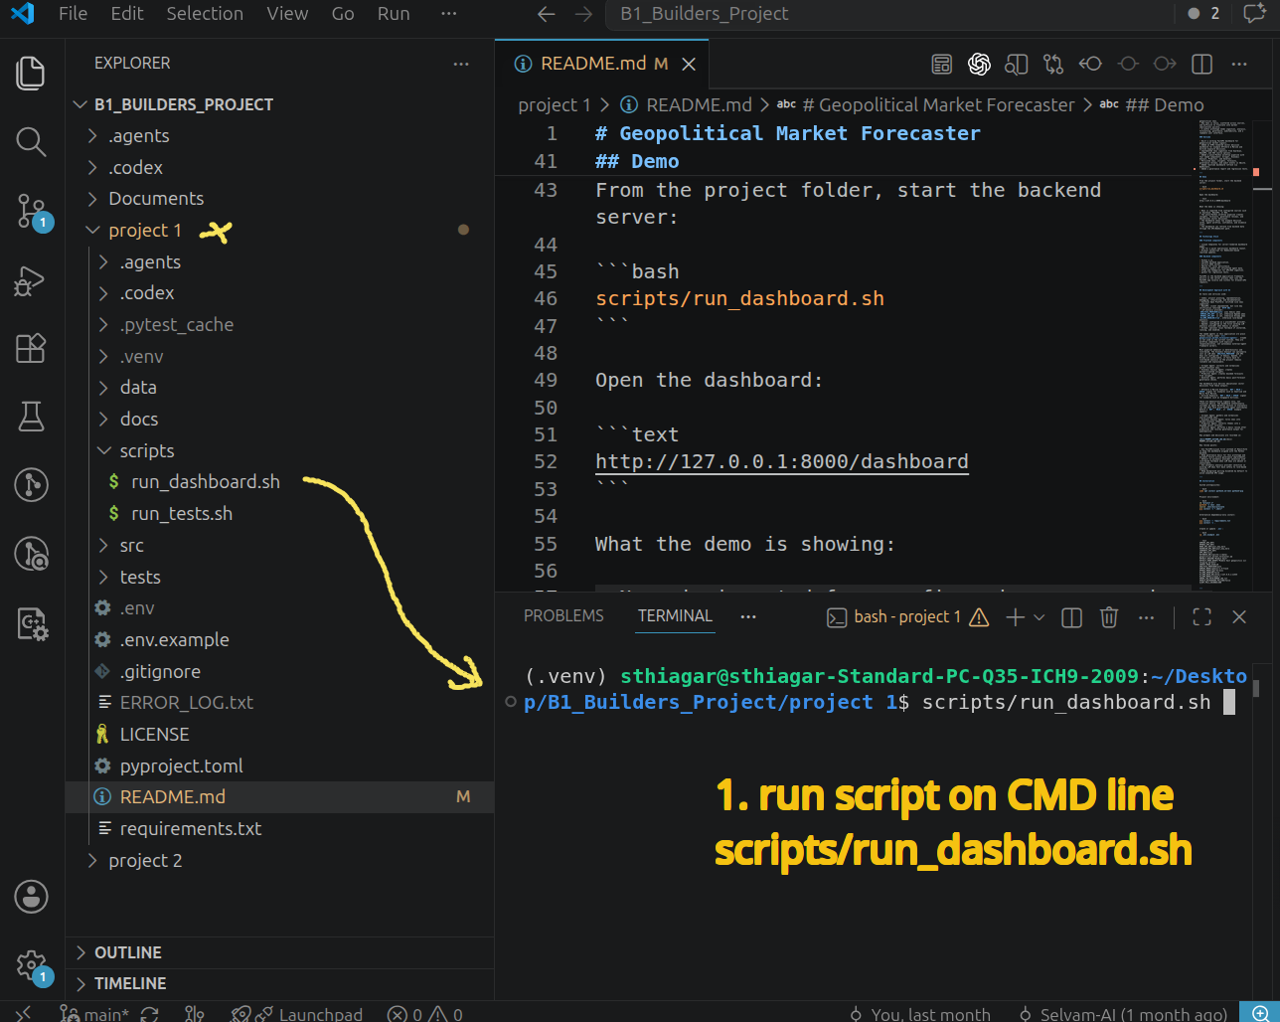
Start Backend server from the project folder::
$ cd "project 1"
$ scripts/run_dashboard.sh

Slide 2
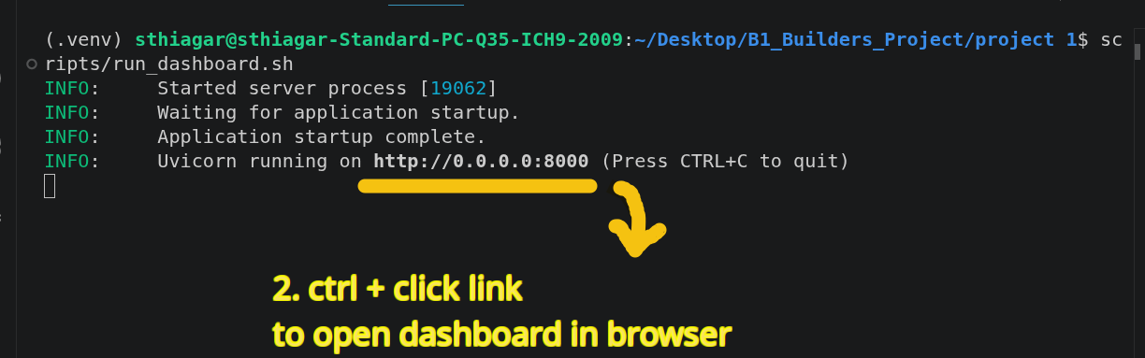
Backend server has started.
Open the dashboard in browser.

Slide 3
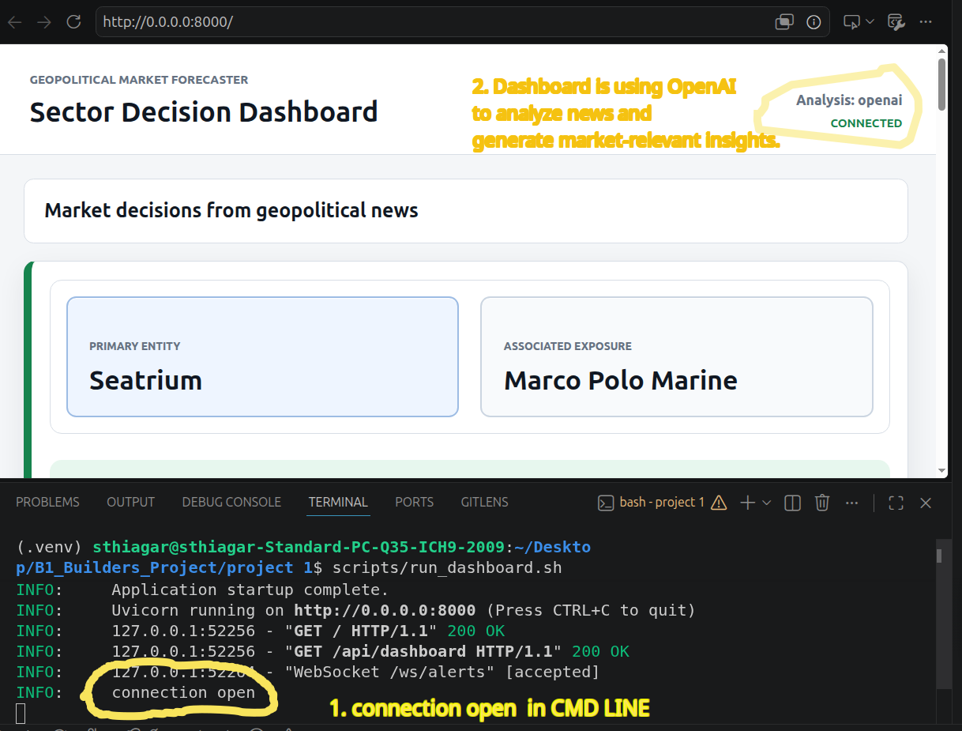
1. command line – shows connection open with browser and backend server.
2. In browser Dashboard is shown to use Openai. More on this further up.

Slide 4
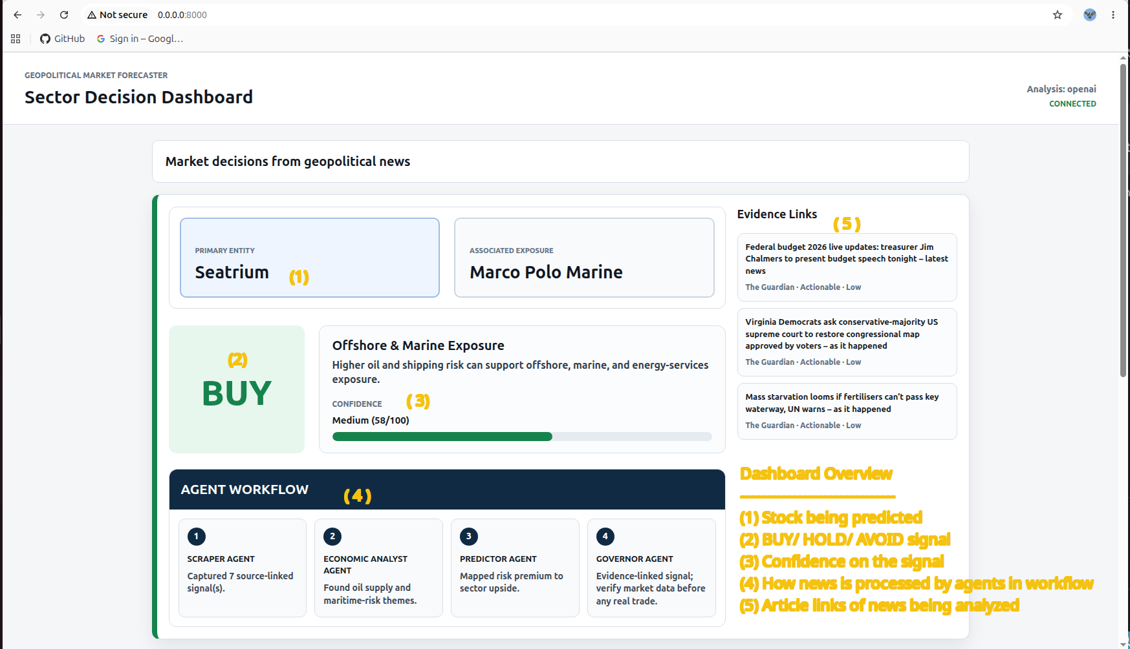

Slide 5
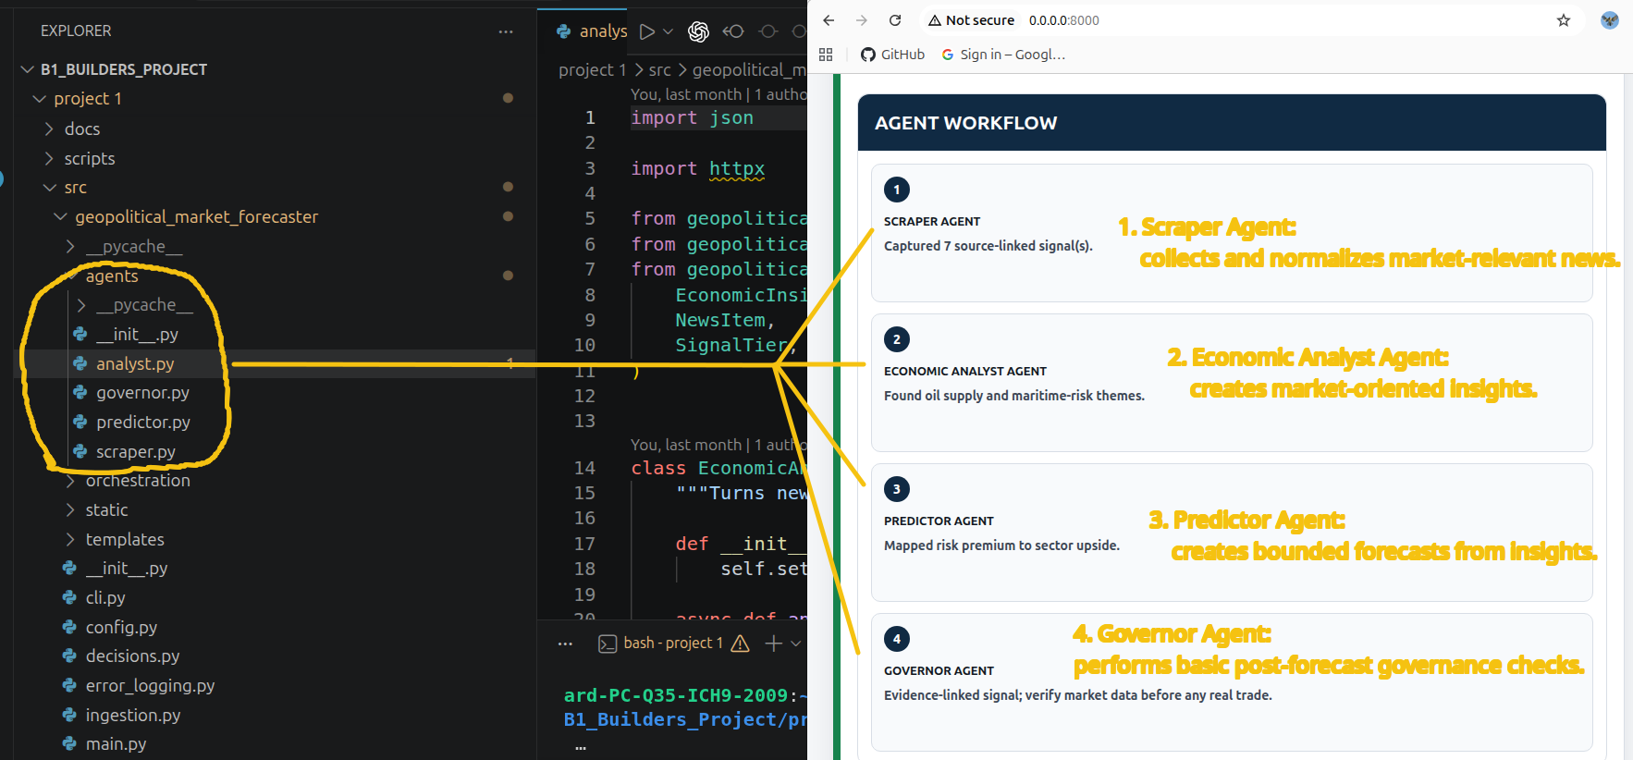

Slide 6
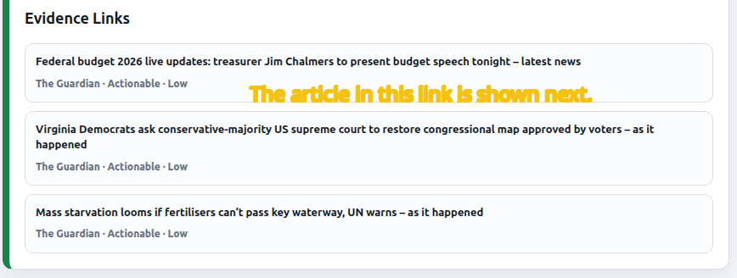
The Scraper Agent collects the relevant news below based on criteria -
- Middle East geopolitical events
- Oil supply or oil price risk
- Shipping disruption
- Aviation disruption
- Regional instability or conflict
- News that may affect sectors like Offshore & Marine or Airlines

Slide 7
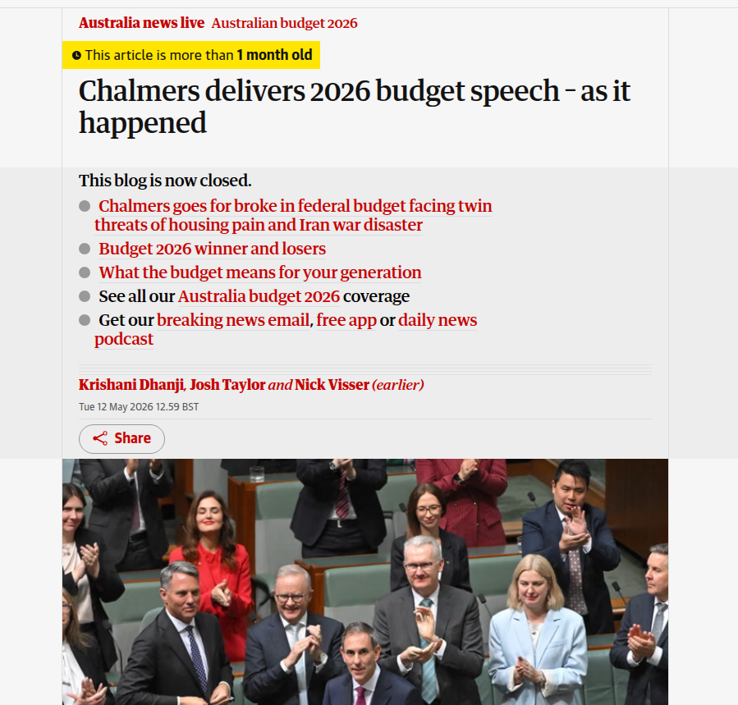
An article from the link.

Slide 8
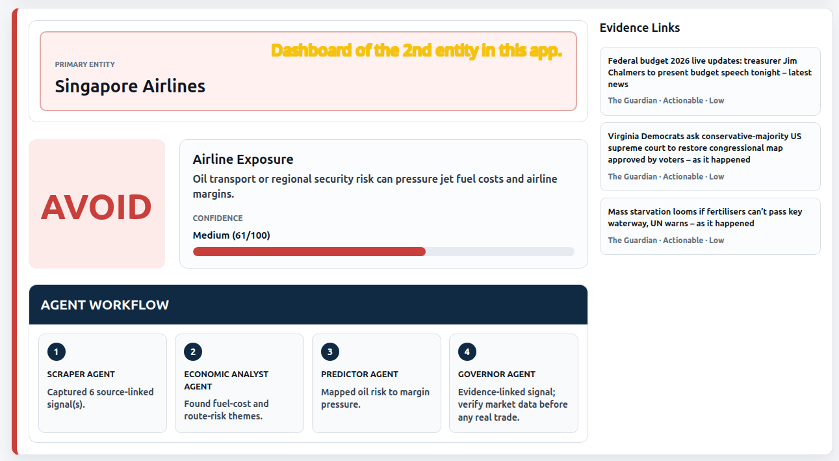

Slide 9
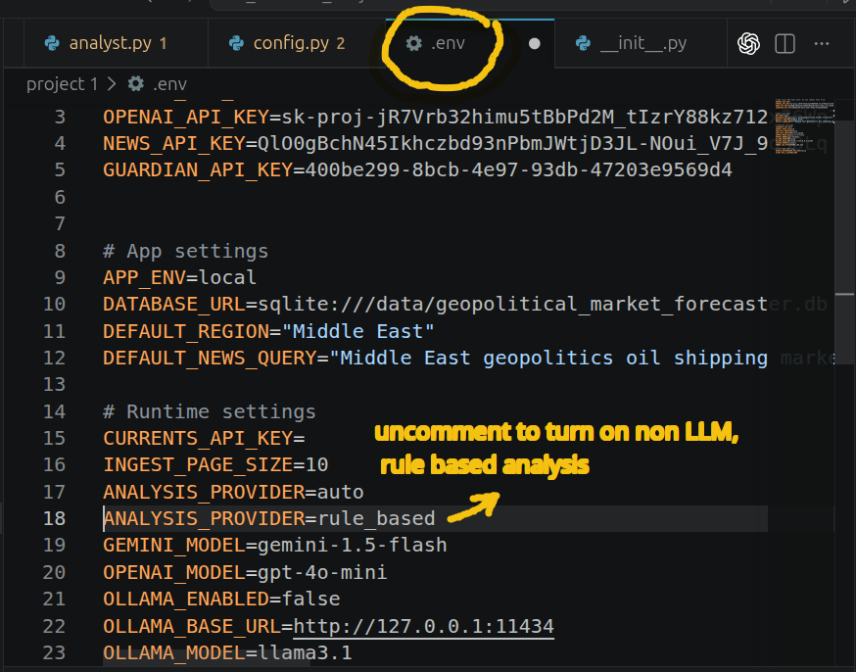
How you may switch from OpenAI to Rule based analysis.
Uncomment the constant in the .env file.

Slide 10
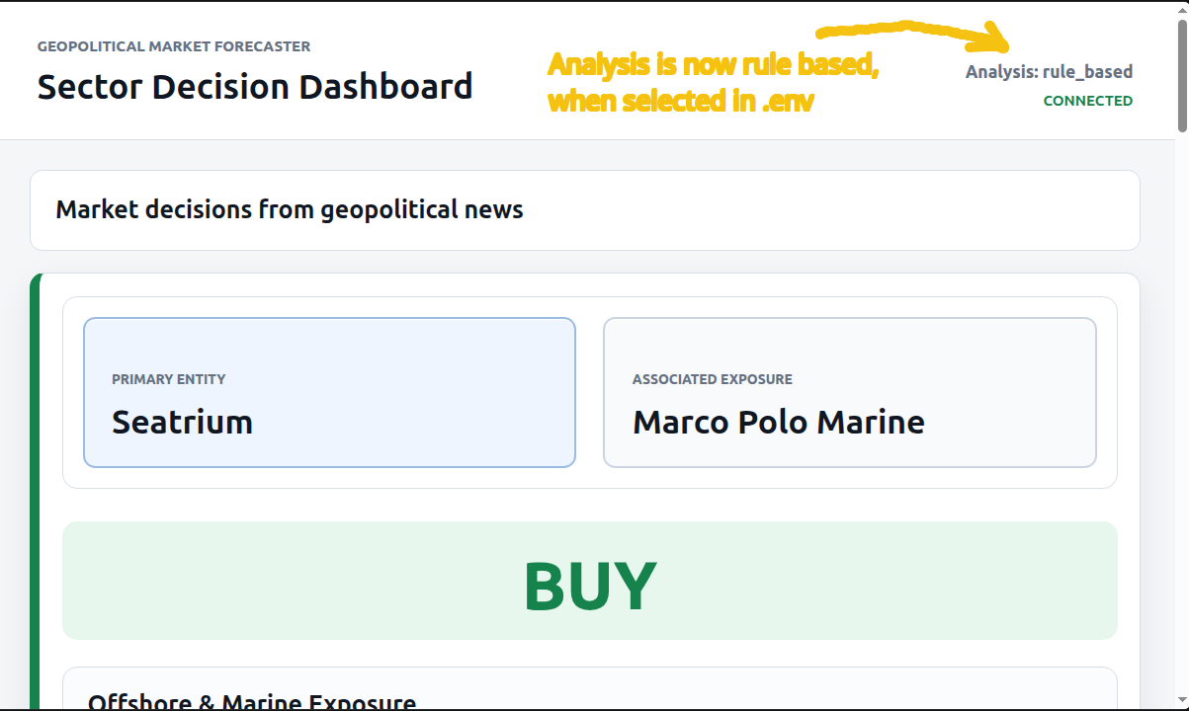

Slide 11
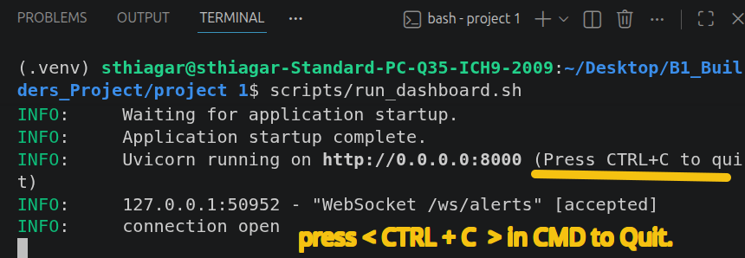
To stop the backend server.
Press ctrl + c in command line.

